Slide 1


Ordinarily available inclusive provision

Slide 2

Ordinarily available inclusive provision (OAIP)
School and classroom practice that is essential for some, helpful for most and harmful to none.

Slide 3

SEND Framework from Devon
We are committed to using this framework within our schools.
The OAIP describes the inclusive provision and practice that all Devon schools, Early Years and Post 16 settings should be able to provide for all children and young people, including those of SEND from their own resources.
This will support all children to attend, engage and thrive in their educational setting.

Slide 4

The Framework defines:
How teachers make enhanced adaptations to their daily teaching.
How teachers make decisions about provision and targeted intervention.
How teachers use the SEND Code of Practice to identify and meet needs of learners

Slide 5
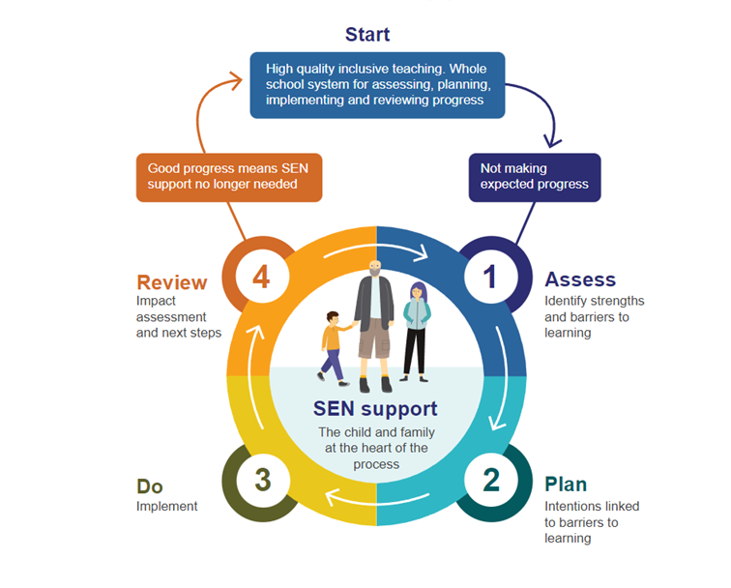
Graduated Response

Slide 6

Meeting the needs of our children
We meet the needs of children regardless of diagnosis.
We meet these needs by closely monitoring and supporting children.
We adapt our practice dynamically and proactively.

Slide 7
Quality first teach
The code of practice states that every teacher is a teacher of SEND.
High quality teaching is effective for all children and young people.
Through delivering quality first teaching, settings are implementing the graduated response.

